Slide 1

Quantifying nonstationary extreme rainfall for resilient stormwater design
in Calvert County
K. Halimeda Kilbourne and Vyacheslav Lyubchich
University of Maryland Center for Environmental Science

Slide 2
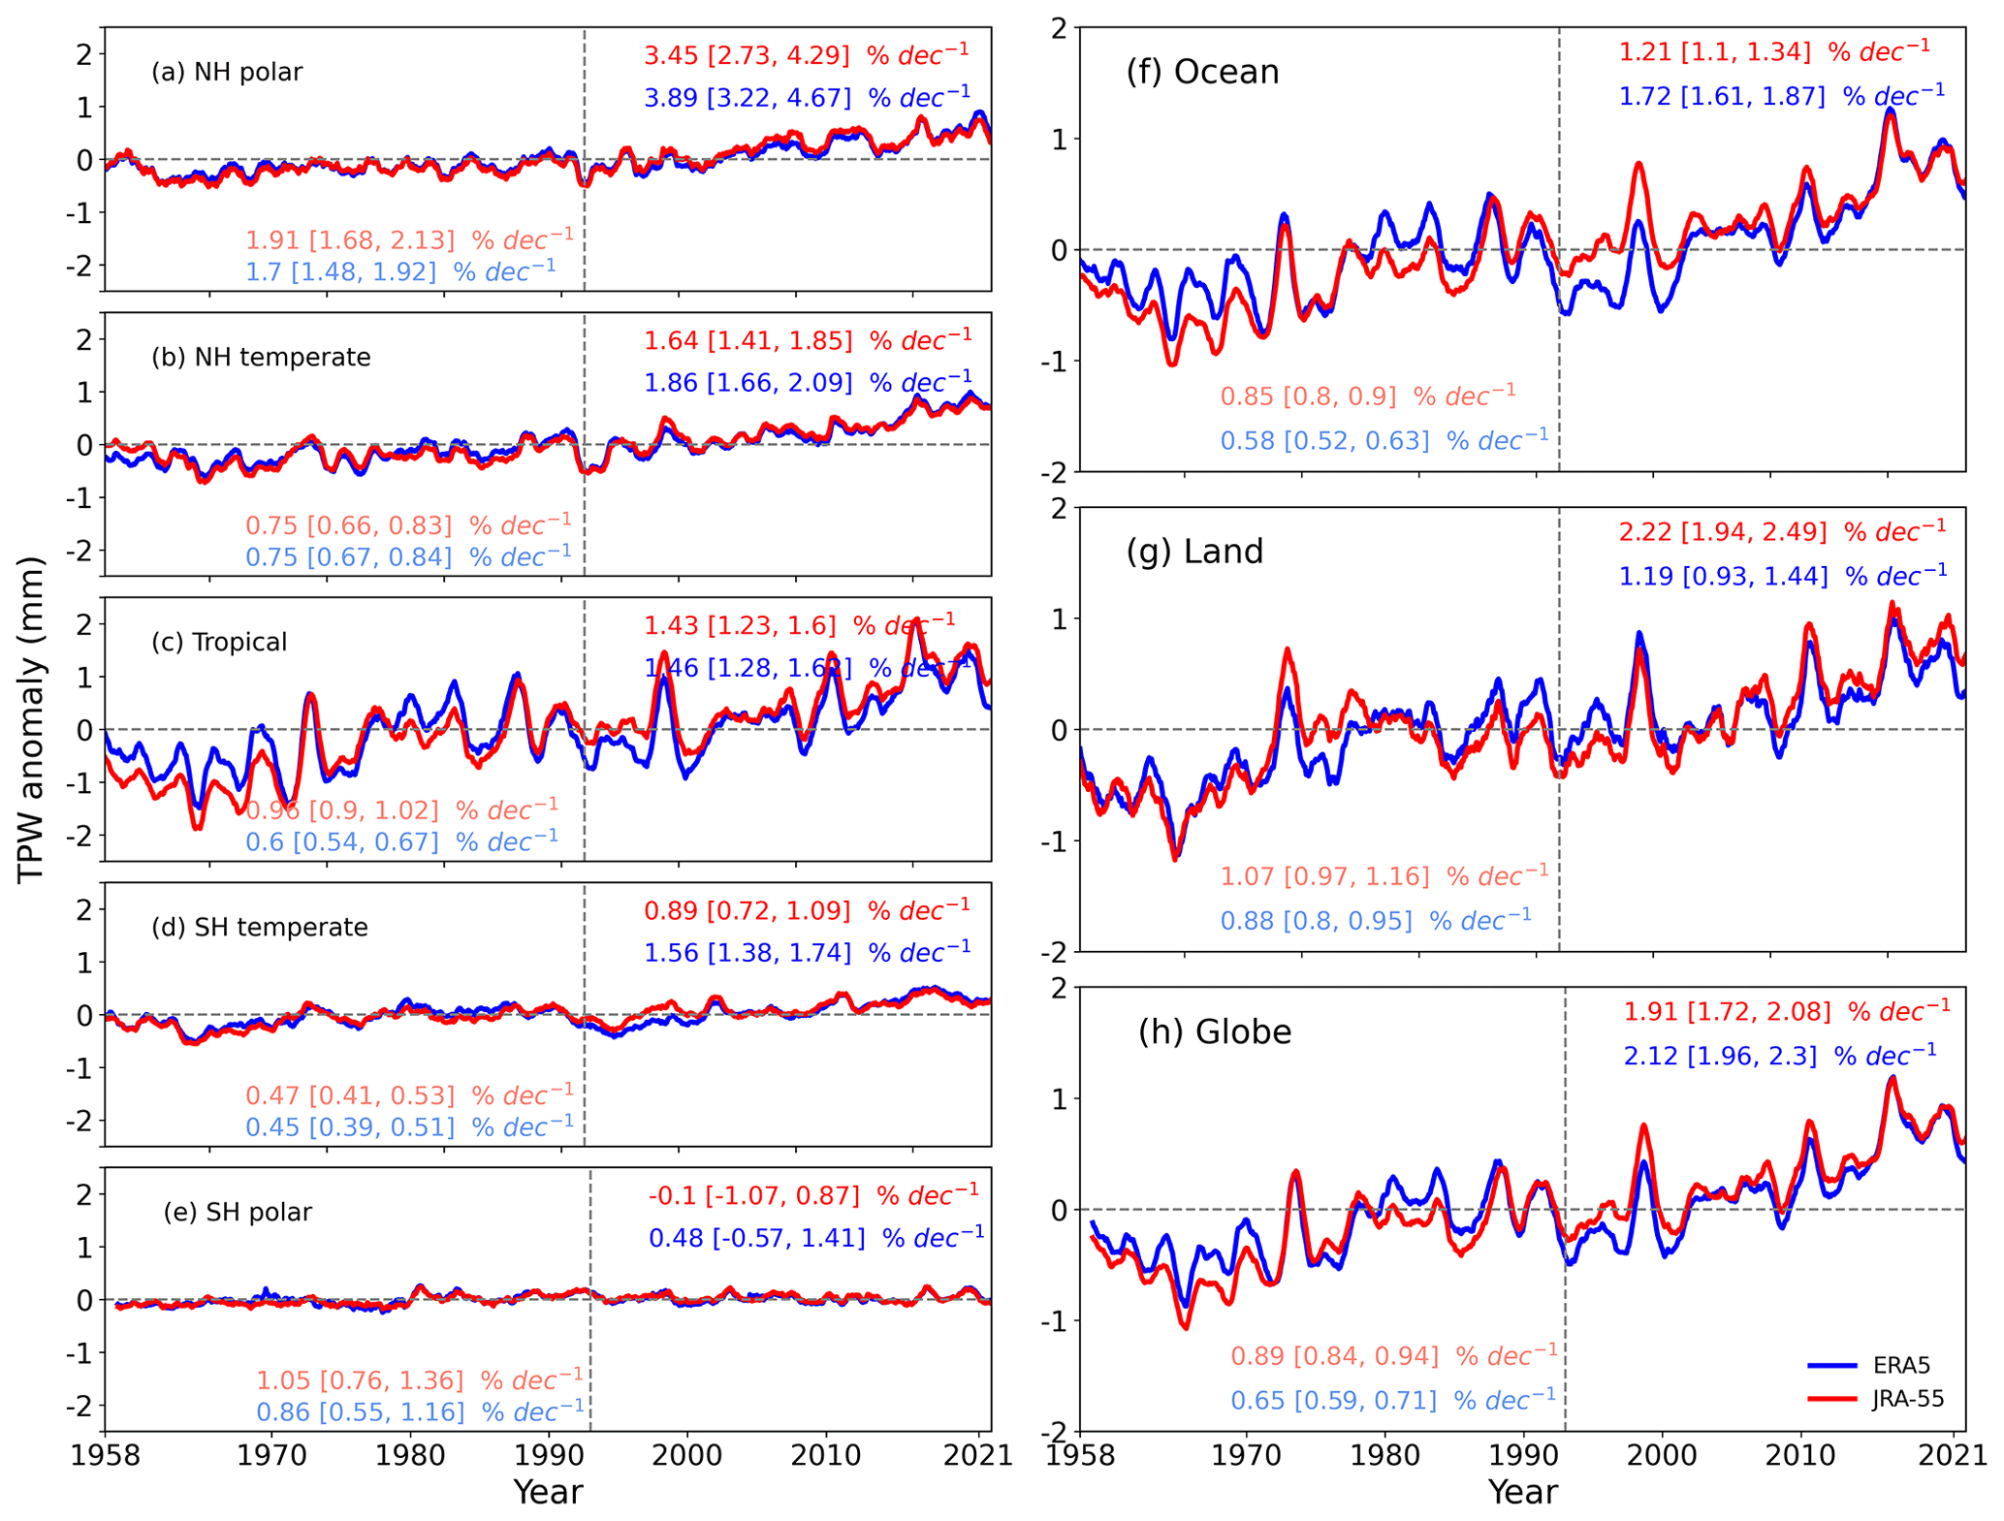
Temperature & Precipitation
Global Precipitable Water Trends
Global temperature has been increasing.
A warmer atmosphere holds more water.
The amount of moisture in the atmosphere available for precipitation has also increased.
Wan et al 2024

Slide 3
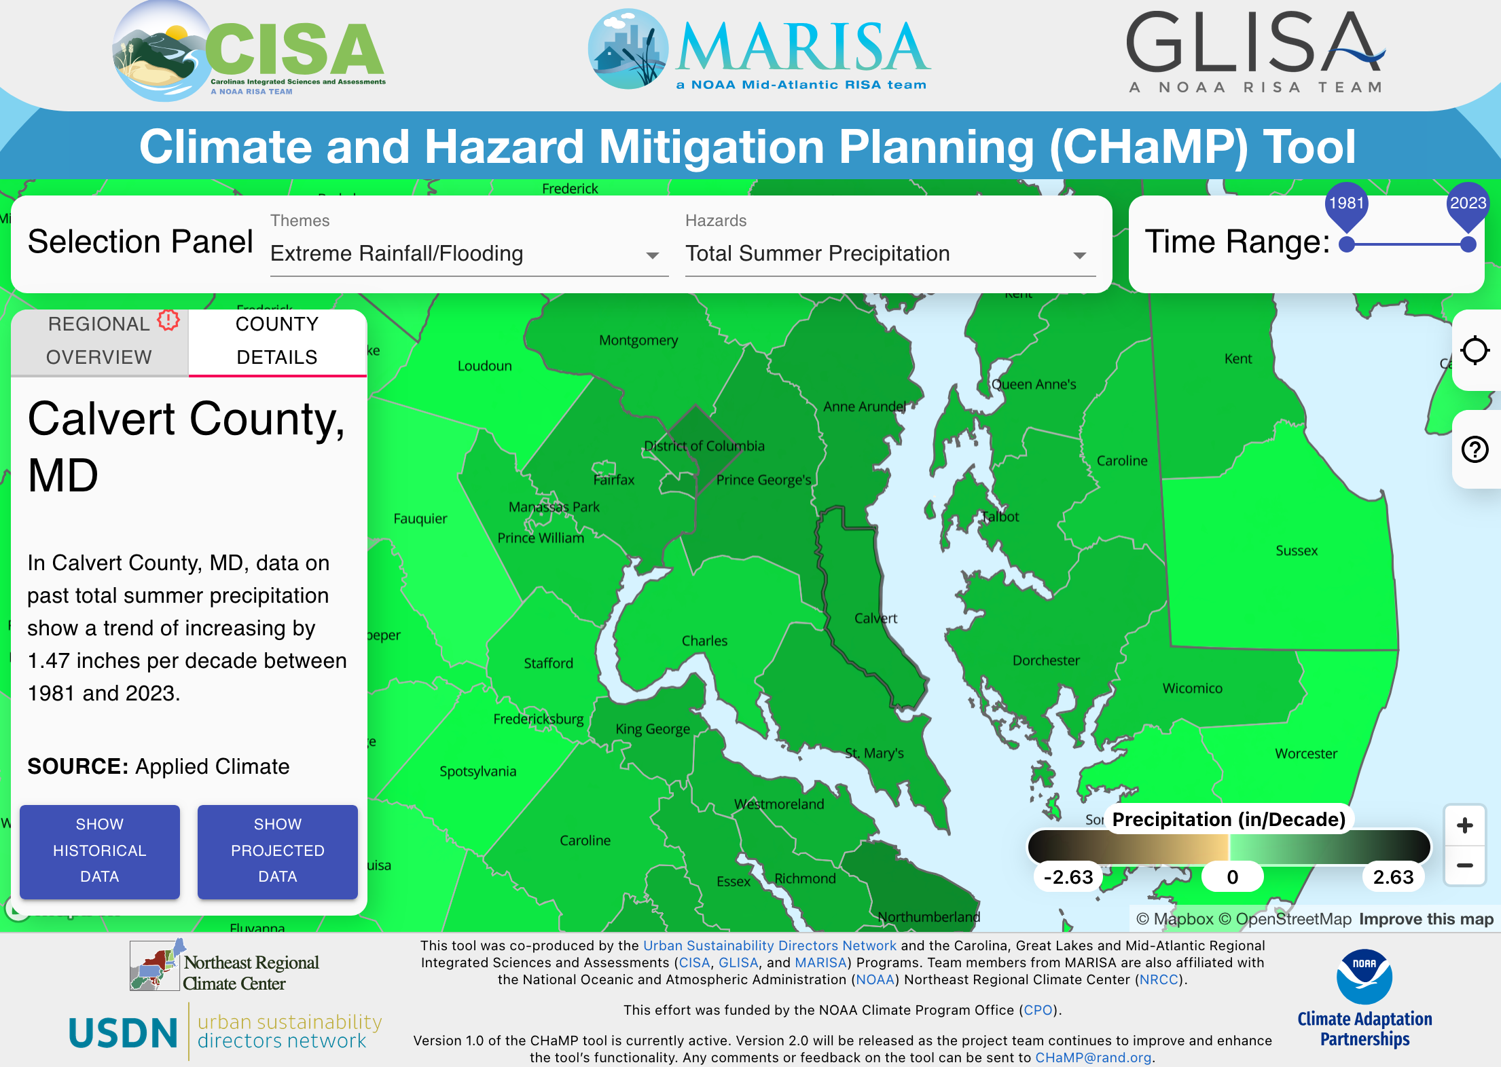
Local Trends
Summer rainfall has strongest trend.
Summer rainfall totals +1.47 in per decade.
Our summer rains are mostly thunderstorms

Slide 4
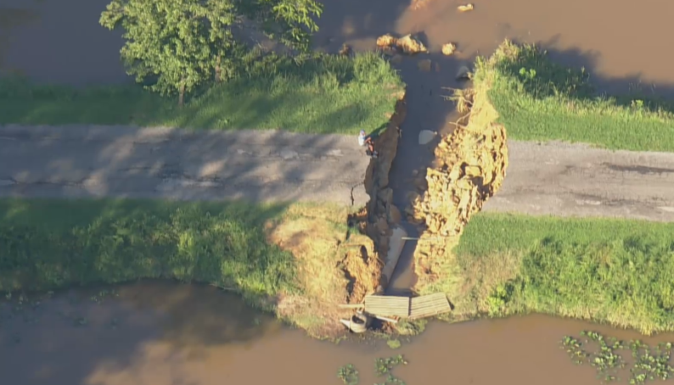
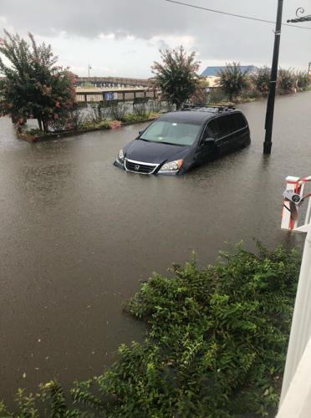
Recent Impacts of Extreme Rainfall in Calvert County
Ox Cart Road in Huntingtown after hurricane Isaias, 2020.
North Beach July 26, 2018
Photo credit: Amy Elliot (SOMD News)

Slide 5
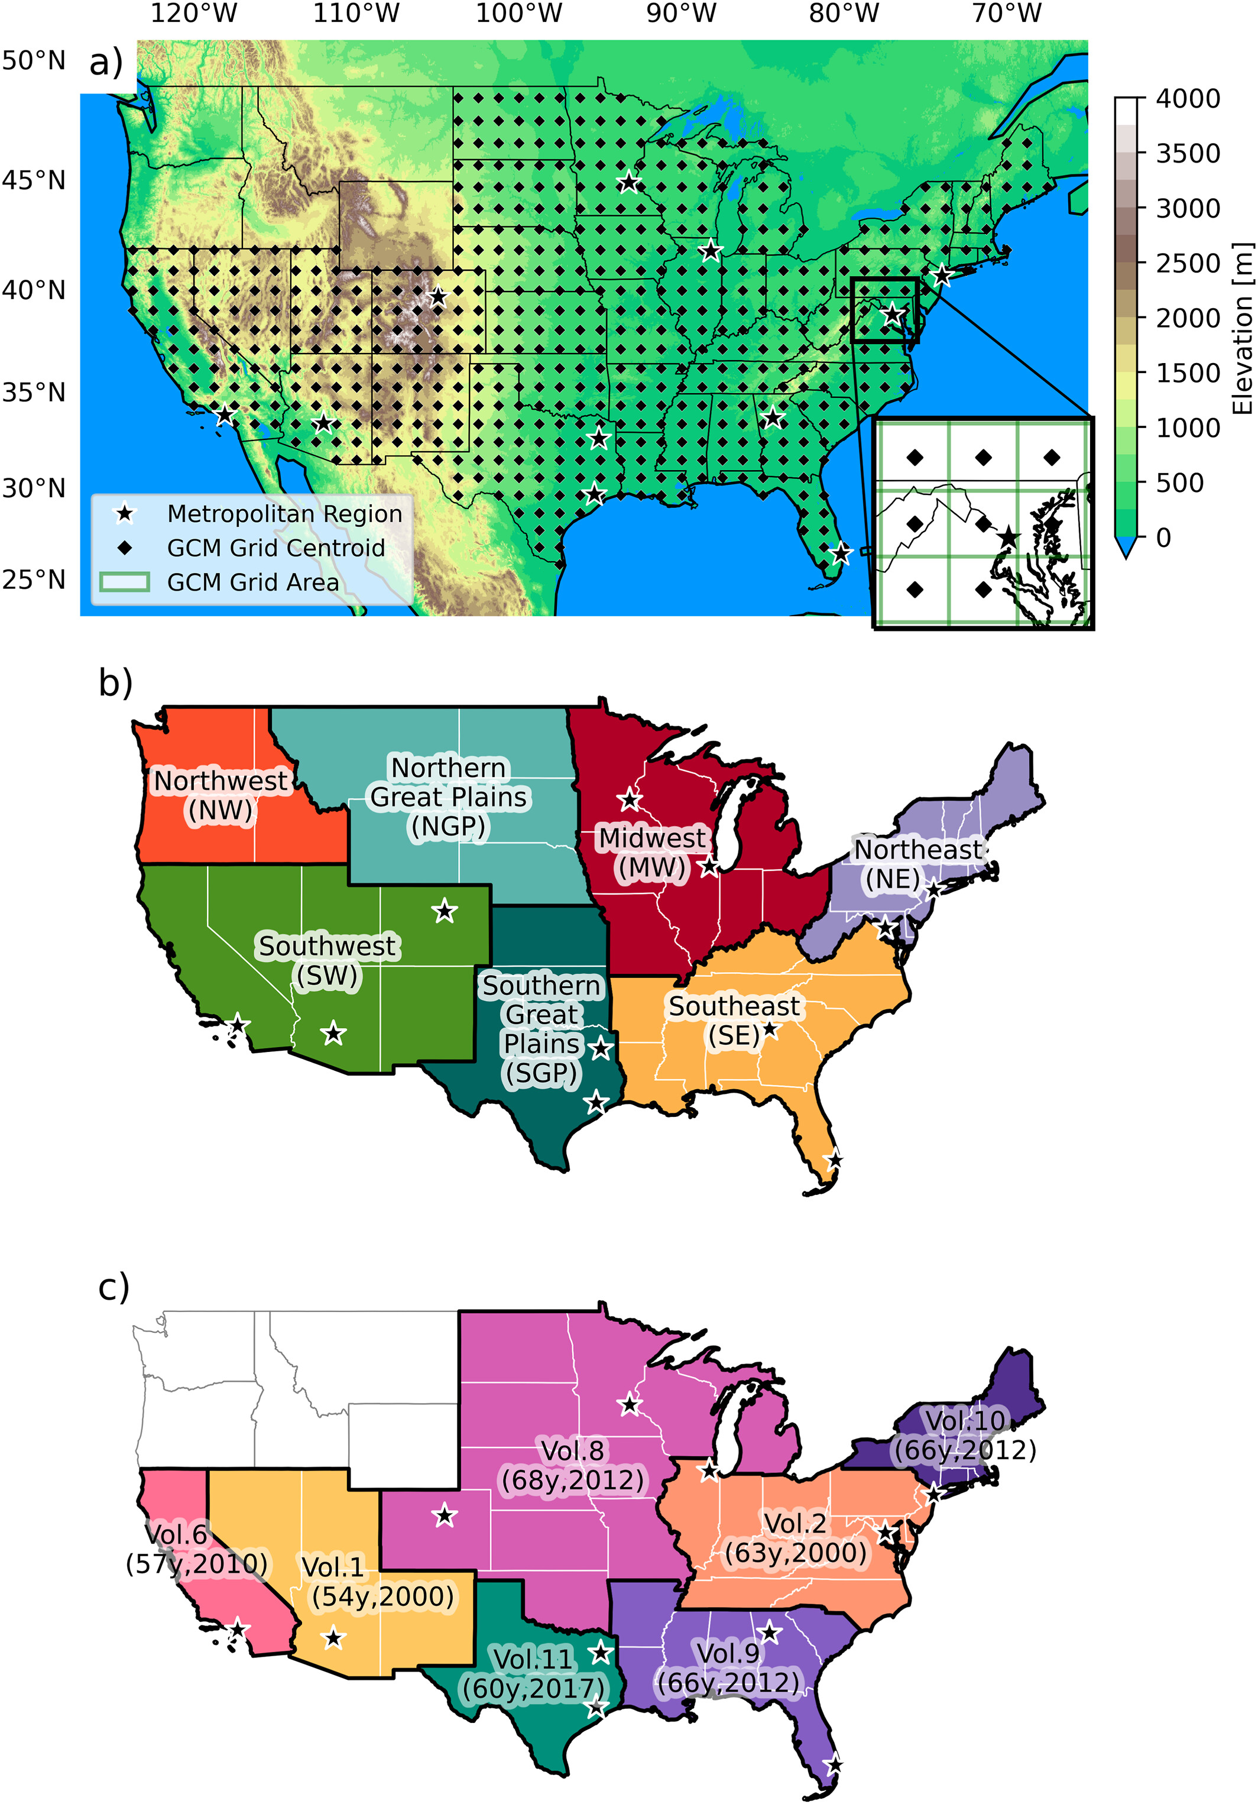
The Challenge of Changing Rainfall
Problem: Escalating impacts of climate change on extreme rainfall events
Traditional Approach: Stormwater infrastructure designed based on historical data (e.g., NOAA Atlas 14)
Reality: Historical records are increasingly insufficient due to:
Increased frequency and intensity of extreme rainfall
New weather extremes set annually
Consequence: Underestimation of risk, inadequate
local planning, and challenges for the insurance
industry
NOAA Atlas 14 Regions (yrs, latest data)

Slide 6
The Problem: Nonstationary Risk & Pluvial Flooding
Climate-Driven Intensification: Mounting evidence of flood intensification
Pluvial Flooding: Flooding from excessive rainfall overwhelming drainage
Often underestimated and inadequately mitigated
Major cause of U.S. flood insurance claims (1978-2021 data)
Exacerbating Human Factors
Increased Impervious Surfaces: Reduced infiltration, enhanced runoff
Inadequate Stormwater Infrastructure: Catastrophic failures (e.g., Hurricanes Katrina, Harvey, St. Louis 2022)
Climate Warming: Directly increases rainfall rates and pluvial flooding frequency

Slide 7
How do we adjust?
Update the data more frequently.
Atlas 14 IDF curves used by many entities in the US are outdated
Atlas 15 is in process for the entire US with updated methods and data
Use projections of current and expected conditions to estimate design thresholds.
Scale existing guidance up by some factor – depends on:
How we think future changes will develop (largely dependent on GHG policies and implementation).
Different models and analysis techniques give slightly different results.
The timeline of the project (how long in the future do we build for).
Risk of failure (high consequence of failure projects need lower probability of failure designs).

Slide 8
Scales of the problem:
Atlas 14
Atlas 14 is what we still have in most local ordinance.
It did not include the northwestern states.
It generally used ~60 years of data
The most recent data in our region are from 2000.
Coelho eta l., 2022: Potential Impacts of Future Extreme Precipitation Changes on Flood Engineering Design Across the Contiguous United States, Water Resources Research, Volume: 58, Issue: 4, First published: 29 March 2022, DOI: (10.1029/2021WR031432)
Notes:
(a) Contiguous United States with the indication of the global climate model (GCM) grid centroids overlapping National Oceanic and Atmospheric Administration (NOAA) Atlas 14 (study region) and the selected large metropolitan regions (black stars). The zoomed area (lower right) shows an example of the area of influence of the GCM grid; (b) National Climate Assessment regions used in the NC4; and (c) Division of NOAA Atlas 14 volumes and indication of the average length in years and last year of the data series used to prepare the intensity‐duration‐frequency (IDF) curves.
IF THIS IMAGE HAS BEEN PROVIDED BY OR IS OWNED BY A THIRD PARTY, AS INDICATED IN THE CAPTION LINE, THEN FURTHER PERMISSION MAY BE NEEDED BEFORE ANY FURTHER USE. PLEASE CONTACT WILEY'S PERMISSIONS DEPARTMENT ON PERMISSIONS@WILEY.COM OR USE THE RIGHTSLINK SERVICE BY CLICKING ON THE 'REQUEST PERMISSIONS' LINK ACCOMPANYING THIS ARTICLE. WILEY OR AUTHOR OWNED IMAGES MAY BE USED FOR NON-COMMERCIAL PURPOSES, SUBJECT TO PROPER CITATION OF THE ARTICLE, AUTHOR, AND PUBLISHER.

Slide 9
How do we adjust?
Update the data more frequently.
Atlas 14 IDF curves used by many entities in the US are outdated
Atlas 15 is in process for the entire US with updated methods and data – Preliminary data expected in 2025
Use projections of current and expected conditions to estimate design thresholds.
Scale existing guidance up by some factor – depends on:
How we think future changes will develop (largely dependent on GHG policies and implementation).
Different models and analysis techniques give slightly different results.
The timeline of the project (how long in the future do we build for).
Risk of failure (high consequence of failure projects need lower probability of failure designs).

Slide 10
Atlas 15
Brings the analysis into the 21st century digital data world.
Seamless national analysis instead of regional.
Updated every 10 years.
Includes best available projections of future IDF.
Enhanced digital availability of data.

Slide 11
How do we adjust?
Update the data more frequently.
Atlas 14 IDF curves used by many entities in the US are outdated
Atlas 15 is in process for the entire US with updated methods and data – Preliminary data expected in 2025
Use projections of current and expected conditions to estimate design thresholds.
Scale existing guidance up by some factor – depends on:
How we think future changes will develop (largely dependent on GHG policies and implementation).
Different models and analysis techniques give slightly different results.
The timeline of the project (how long in the future do we build for).
Risk of failure (high consequence of failure projects need lower probability of failure designs).

Slide 12
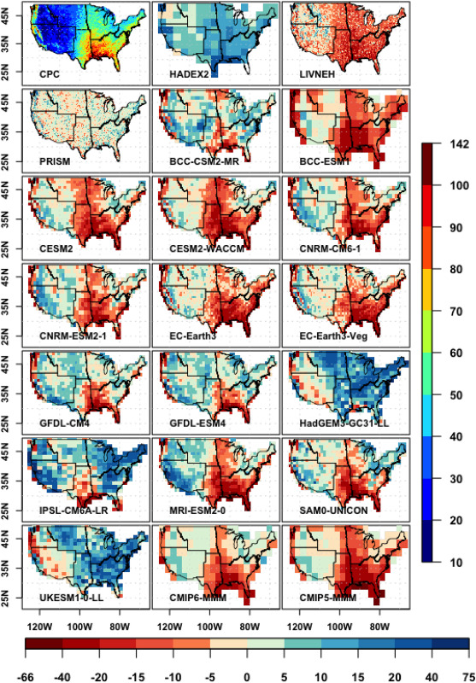
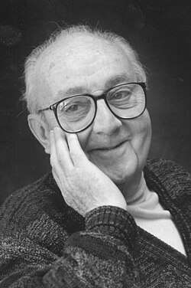
All models are wrong, but some are useful
G. E. P. Box
Different global climate prediction models have different biases in their extreme rainfall.
Most have a low-bias in the East and Southeast, where convective rainfall is a substantial source of extreme rain and a cause of recent trends.
Summertime convective rain (thunderstorms) have to be parameterized at this scale.
Fig. 6. Bias in the 1981–2005 time mean of bias in annual maximum 1-day precipitation amount (Rx1day). The first panel shows mean annual maximum 1-day precipitation in the reference (CPC) dataset on its native 0.25° x 0.25° grid and uses the color scale along the right edge of the figure. The other panels show bias (dataset minus CPC) on each dataset's native grid and use the color scale along the bottom edge of the figure. Units are in mm/day. Srivastava et al., 2020 (https://doi.org/10.1016/j.wace.2020.100268)

Slide 13
Scales of the problem:
GCM
The grid for global scale models is coarse.
Grid boxes sometimes average physiographically different locations.
Thunderstorms are not dynamically modeled and thus don’t respond dynamically to changing background conditions.
Coelho eta l., 2022: Potential Impacts of Future Extreme Precipitation Changes on Flood Engineering Design Across the Contiguous United States, Water Resources Research, Volume: 58, Issue: 4, First published: 29 March 2022, DOI: (10.1029/2021WR031432)
Notes:
(a) Contiguous United States with the indication of the global climate model (GCM) grid centroids overlapping National Oceanic and Atmospheric Administration (NOAA) Atlas 14 (study region) and the selected large metropolitan regions (black stars). The zoomed area (lower right) shows an example of the area of influence of the GCM grid; (b) National Climate Assessment regions used in the NC4; and (c) Division of NOAA Atlas 14 volumes and indication of the average length in years and last year of the data series used to prepare the intensity‐duration‐frequency (IDF) curves.
IF THIS IMAGE HAS BEEN PROVIDED BY OR IS OWNED BY A THIRD PARTY, AS INDICATED IN THE CAPTION LINE, THEN FURTHER PERMISSION MAY BE NEEDED BEFORE ANY FURTHER USE. PLEASE CONTACT WILEY'S PERMISSIONS DEPARTMENT ON PERMISSIONS@WILEY.COM OR USE THE RIGHTSLINK SERVICE BY CLICKING ON THE 'REQUEST PERMISSIONS' LINK ACCOMPANYING THIS ARTICLE. WILEY OR AUTHOR OWNED IMAGES MAY BE USED FOR NON-COMMERCIAL PURPOSES, SUBJECT TO PROPER CITATION OF THE ARTICLE, AUTHOR, AND PUBLISHER.

Slide 14
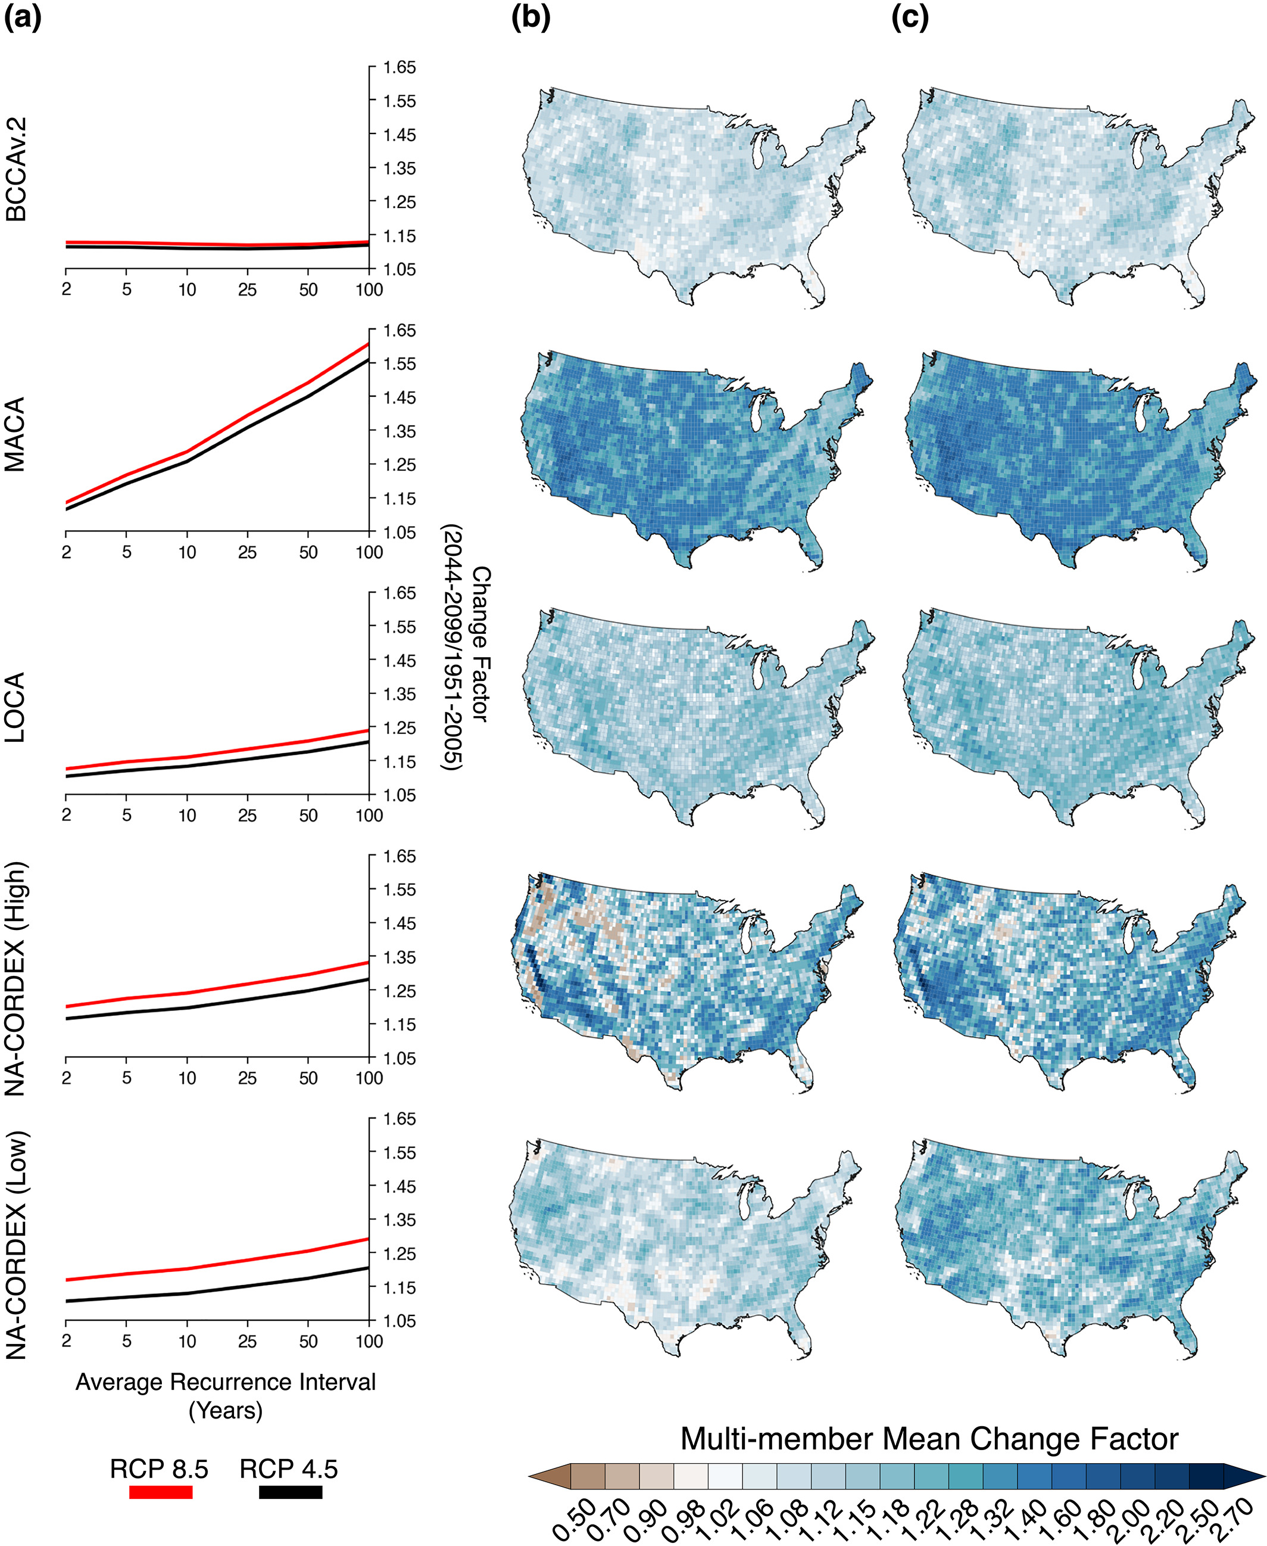
Uncertainties in Future U.S. Extreme Precipitation From Downscaled Climate Projections
Dynamical and statistical downscaling of global GCM could be helpful.
Extreme rainfall trends from different downscaled models differ a lot in both space and the frequency distribution of the rainfall.
They also differ in their sensitivity to GHG forcing.
Lopez-Cantu et al., 2020 Geophysical Research Letters, Volume: 47, Issue: 9, DOI: (10.1029/2019GL086797)
Notes:
Future (2044–2099) extreme rainfall volumes are increasing in all data sets with larger increases for large ARI events and under RCP 8.5 compared to the past (1951–2005). Multimember mean extreme rainfall signal averaged across the United States for different ARIs (a), spatial distribution of the 25‐year event change factors under RCP 4.5 (b), and RCP 8.5 (c). Each data set member was weighted equally in the multimember mean computation.
IF THIS IMAGE HAS BEEN PROVIDED BY OR IS OWNED BY A THIRD PARTY, AS INDICATED IN THE CAPTION LINE, THEN FURTHER PERMISSION MAY BE NEEDED BEFORE ANY FURTHER USE. PLEASE CONTACT WILEY'S PERMISSIONS DEPARTMENT ON PERMISSIONS@WILEY.COM OR USE THE RIGHTSLINK SERVICE BY CLICKING ON THE 'REQUEST PERMISSIONS' LINK ACCOMPANYING THIS ARTICLE. WILEY OR AUTHOR OWNED IMAGES MAY BE USED FOR NON-COMMERCIAL PURPOSES, SUBJECT TO PROPER CITATION OF THE ARTICLE, AUTHOR, AND PUBLISHER.

Slide 15
Convection Permitting Model Projections: Weather Model Run with Future Conditions
Model run 13 yrs with modern background conditions based on obs 2001-2013.
Model run 13 yrs with background conditions based on CMIP6 2070-2100, RCP8.5 (business as usual).
Difference maps indicate future:
Mostly wetter conditions
Summertime drying in the moderate rainfall
More extreme rainfall.
Approx. equivalent to annual max rainfall

Slide 16
Summary and Scientific Motivation for this Project
Our local rainfall trends are from convective activity (thunderstorms)
How well do the downscaled models capture summer thunderstorms?
Not a strong point
What tool do we have available that does capture summer thunderstorm physics?
Super high resolution models (essentially weather models)
Does a high resolution model capture recent rainfall patterns and are the projections of future rainfall in the model different from more standard projections?

Slide 17
Project Objectives
Assess Trends: Evaluate trends in heavy rainfall statistics relevant for stormwater management designs in Calvert County
Suggest Modifications: Propose revisions to design thresholds by incorporating the most recent regional climate dynamics and uncertainties
Overall Goal: Enable Calvert County to adjust regulatory standards, thereby reducing flood risks and impacts

Slide 18
Data Sources: A Multi-Dataset Approach
Purpose: Combine historical records with future projections to assess trends
1. NOAA Global Hourly Precipitation (ISD DSI-3505)
Station-based hourly time series (1945–2023); from Calvert, Anne Arundel, St. Mary's Counties; used for long-term trend analysis (24-hour rainfall maxima)
2. NOAA Atlas 14 Annual Maxima
Cleaned and processed historical data (1892–2000); also from the 3 counties; used to assess differences with future expectations using the same IDF estimation methods
3. NASA IMERG Product
Satellite-derived, ground-truthed gridded precipitation (2001–2022); 30-minute temporal, 0.1° (10 km) spatial resolution; represents recent observational period
4. Convection-Permitting Model (CPM) Control Run
Highly-resolved (1-hour, 4 km) historical simulation (2000–2013); baseline for bias correction and comparison with observations. Novel component: Explicitly includes thunderstorms
5. CPM Climate Projections (RCP 8.5)
"Business as usual" climate trajectory (average conditions over 2071–2100); used for future rainfall estimates

Slide 19
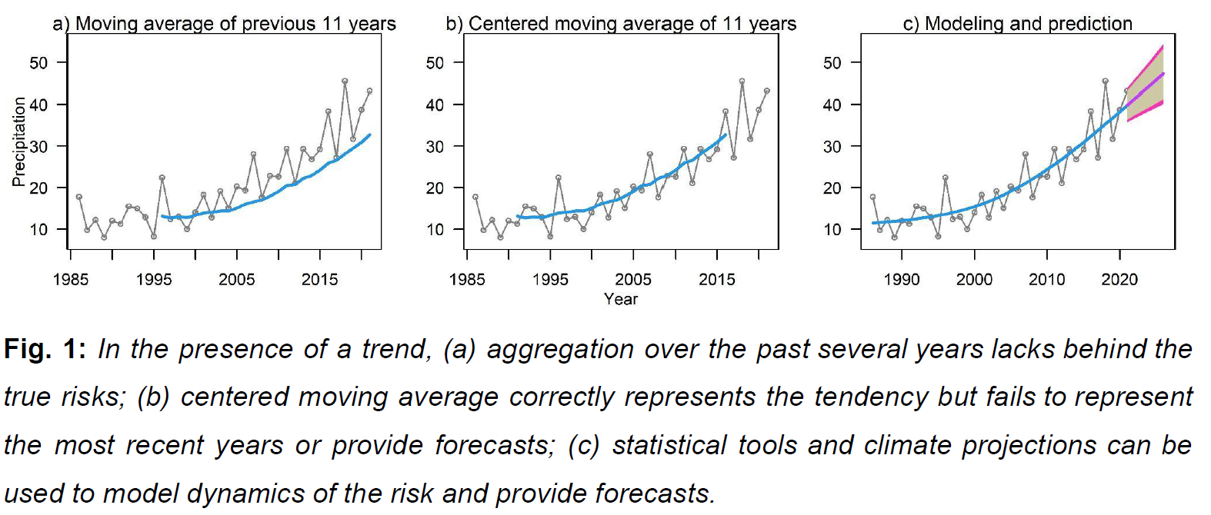
Methods: Statistical Trend Assessment

Slide 20

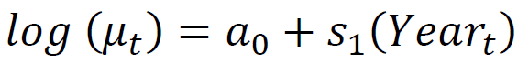
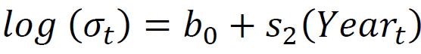
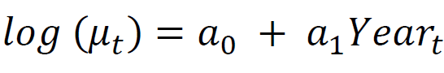
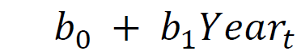
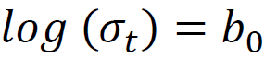
Methods: Trend Assessment in Observational Data

Slide 21
Methods: Bias Correction of Climate Model Output
Purpose: Match the distribution of observed precipitation and climate model output for the same period
Enables accurate estimation of future climate dynamics
Method Selection: 10-fold cross-validation using NASA (observed) and CPM control run (model) hourly precipitation (2001–2012)
Quantile Mapping Methods Assessed
PTF (Parametric Transformations): Exponential tendency to an asymptote
DIST (Distribution Derived): Bernoulli-Gamma mixture distribution
QUANT / RQUANT (Nonparametric Quantile Mapping): Empirical and robust empirical quantiles
SSPLIN (Smoothing Spline): Smoothing spline fit to quantile-quantile plot
Evaluation Criteria: Smallest Mean Absolute Error (MAE) and Root Mean Square Error (RMSE)

Slide 22
Methods: IDF & DDF Estimation and Uncertainty Quantification
Fit a Generalized Extreme Value (GEV) distribution to the annual maxima for each duration
DDF Curves: Calculate return levels for durations and return periods (2, 5, 10, 25, 50, 100 years)
IDF Curves: Derived from DDF curves by adjusting return levels for intensity
Uncertainty Quantification (Bootstrap Procedure)
Resampling: Resample spatial grid cells with replacement 1000 times
Re-estimation: Re-estimate IDF and DDF curves (fitting GEV) for all durations on each dataset
Confidence Intervals: Calculate 2.5th/97.5th percentiles (95% CI) and 10th/90th percentiles (80% CI) from the distribution of estimated return levels

Slide 23
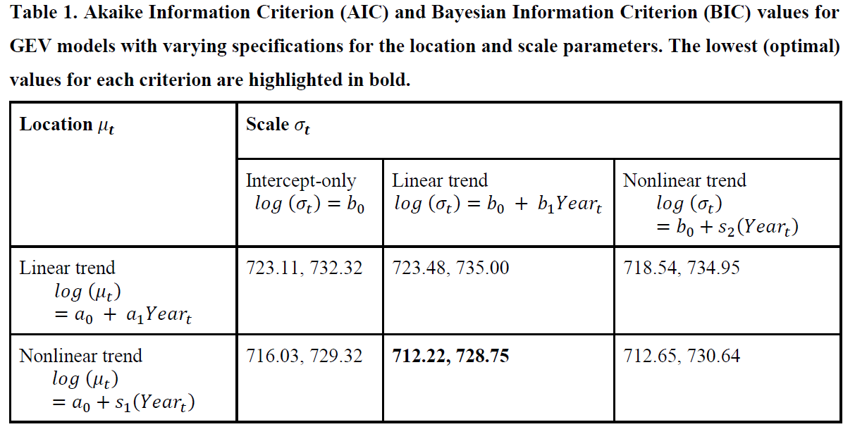
Results: Trend Model Selection

Slide 24
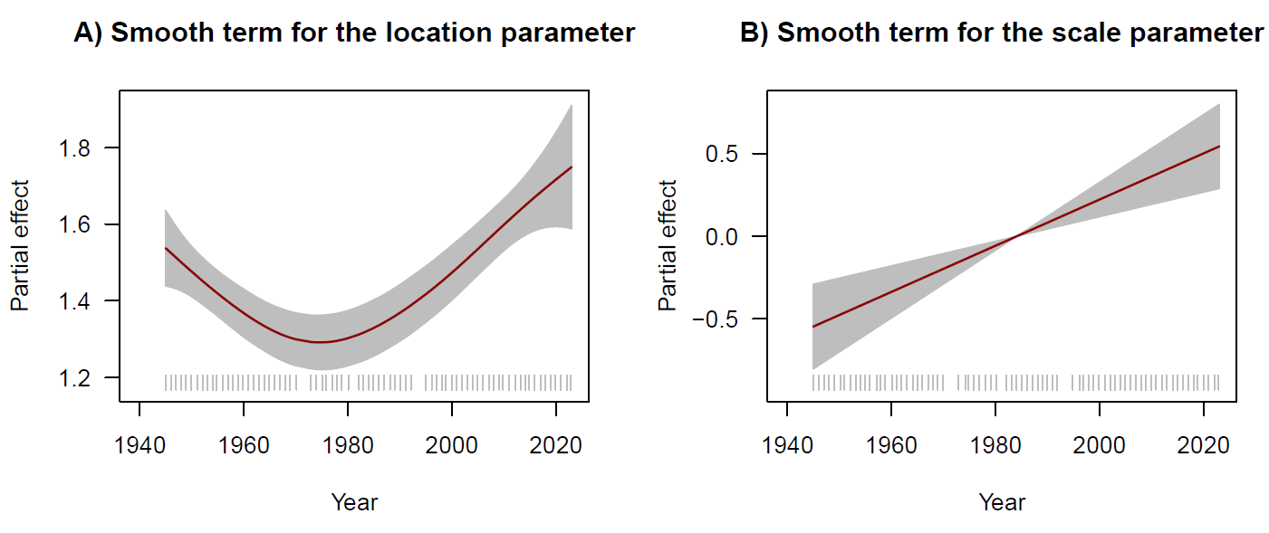

Results: Trend Assessment

Slide 25
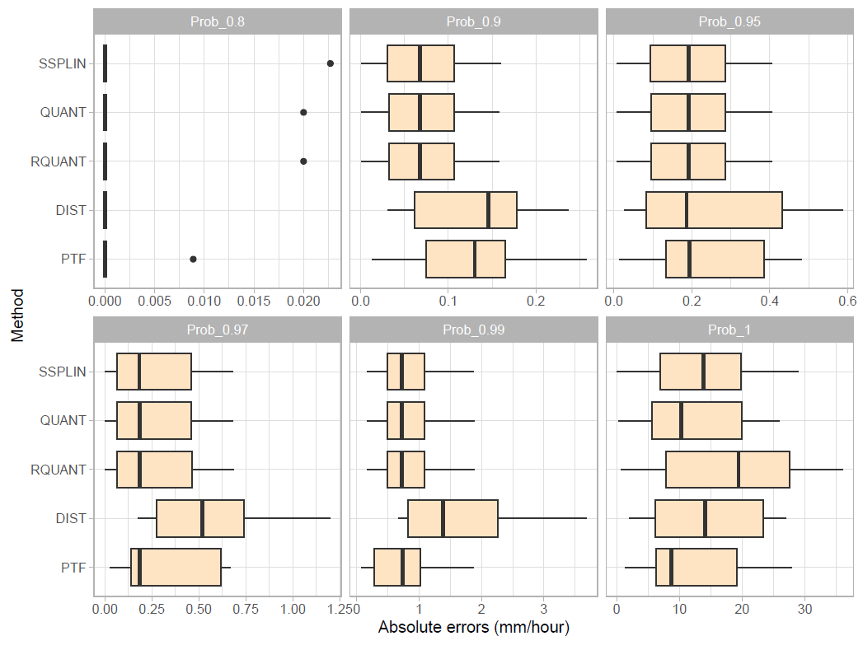
Results: Bias Correction
QUANT method consistently yielded the lowest MAE and RMSE
Verification: Trivial difference between NASA data and bias-corrected model control run quantiles in the 2001–2012 training period
Key Observation: For probabilities > 0.9, bias-corrected control run quantiles were lower than observed quantiles from the full 2001–2022 NASA data
Suggests an increase in extreme precipitation during 2013–2022, supporting trend inference
Bias-corrected model projections show a further expected increase in the most extreme precipitation

Slide 26
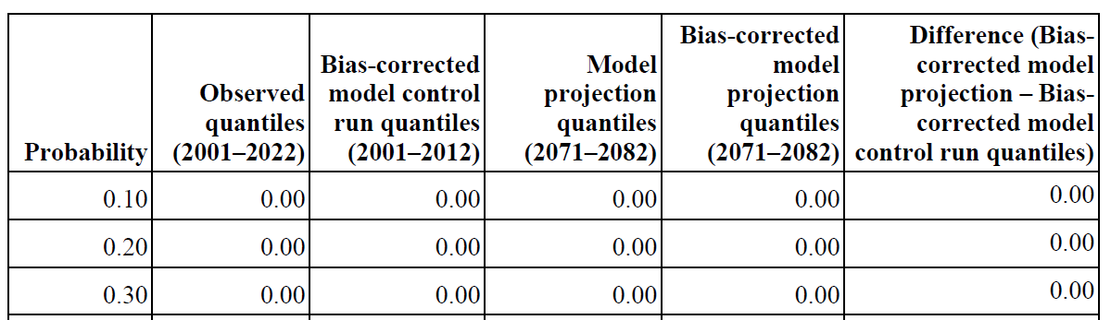
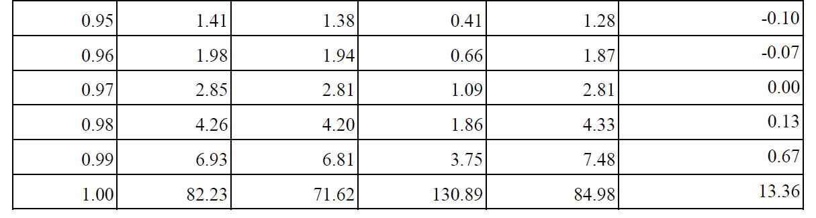
Results: Bias Correction Output

Slide 27
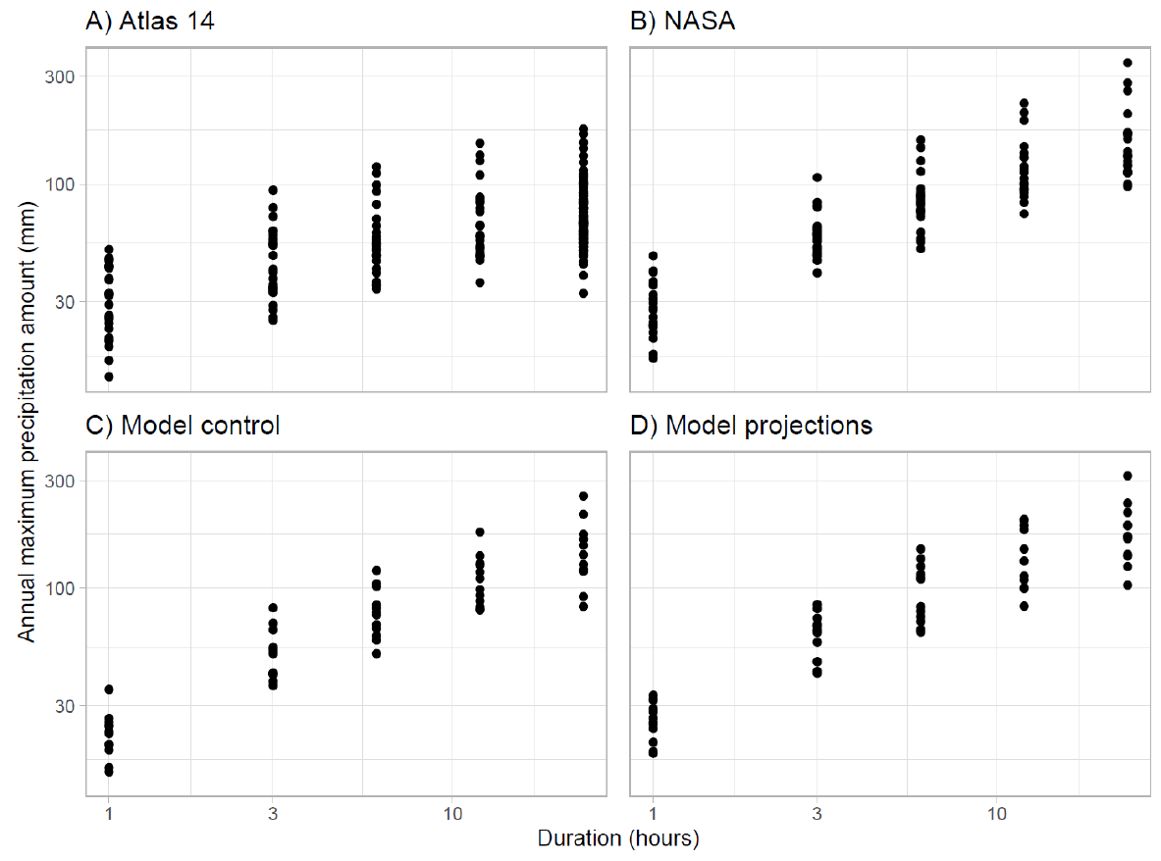
Results: Data for IDF and DDF Curves

Slide 28
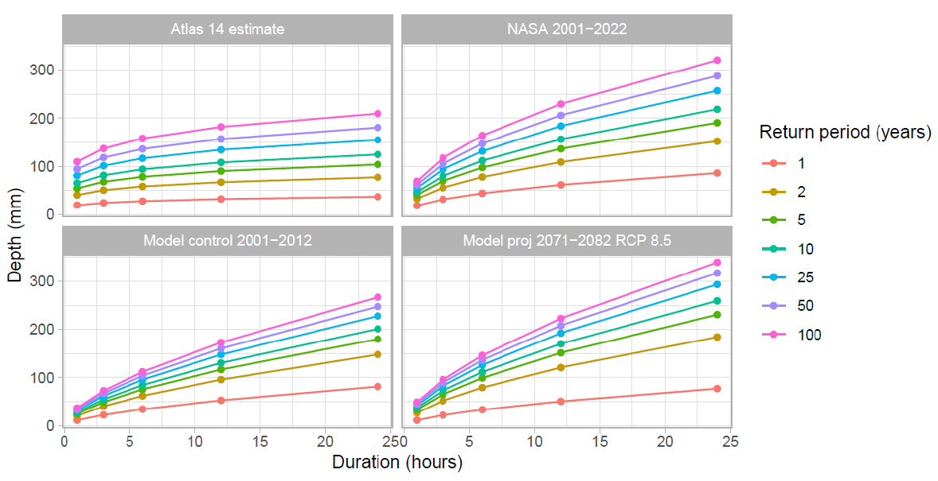
Results: DDF Curves

Slide 29
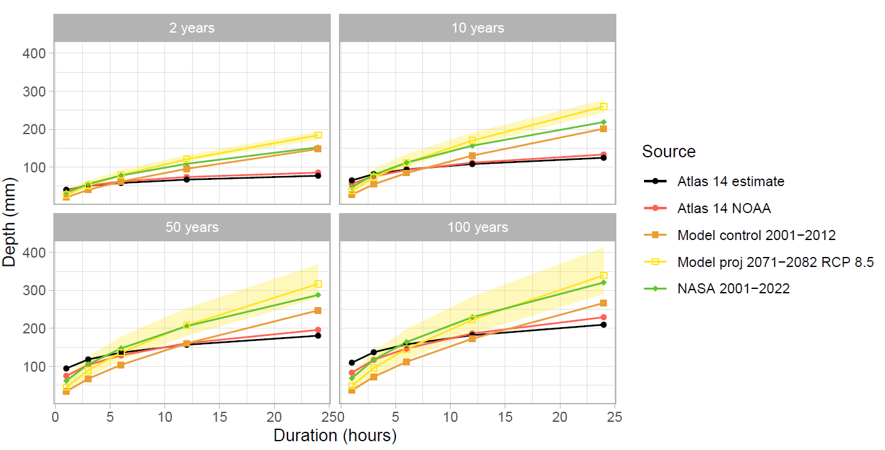
Results: IDF and DDF Curves
Estimates from bias-adjusted model projections are consistently higher than observed or control run data
Suggests a clear pattern towards more extreme rainfall in the future, warranting further exploration

Slide 30
Discussion: Key Insights
Consistency with Atlas 14: General consistency but notable differences at varying durations
Recent NASA data (2001–2022) show substantially steeper DDF curves for longer durations (12 and 24 hours) compared to historical Atlas 14 (pre-2000)
Confirms nonstationary nature of extreme rainfall; historical records underestimate current conditions
Importance of Temporal Consistency: Bias correction effectively aligns quantiles over matched timeframes
Comparisons must be done over the same period to avoid confounding temporal changes with other data differences

Slide 31
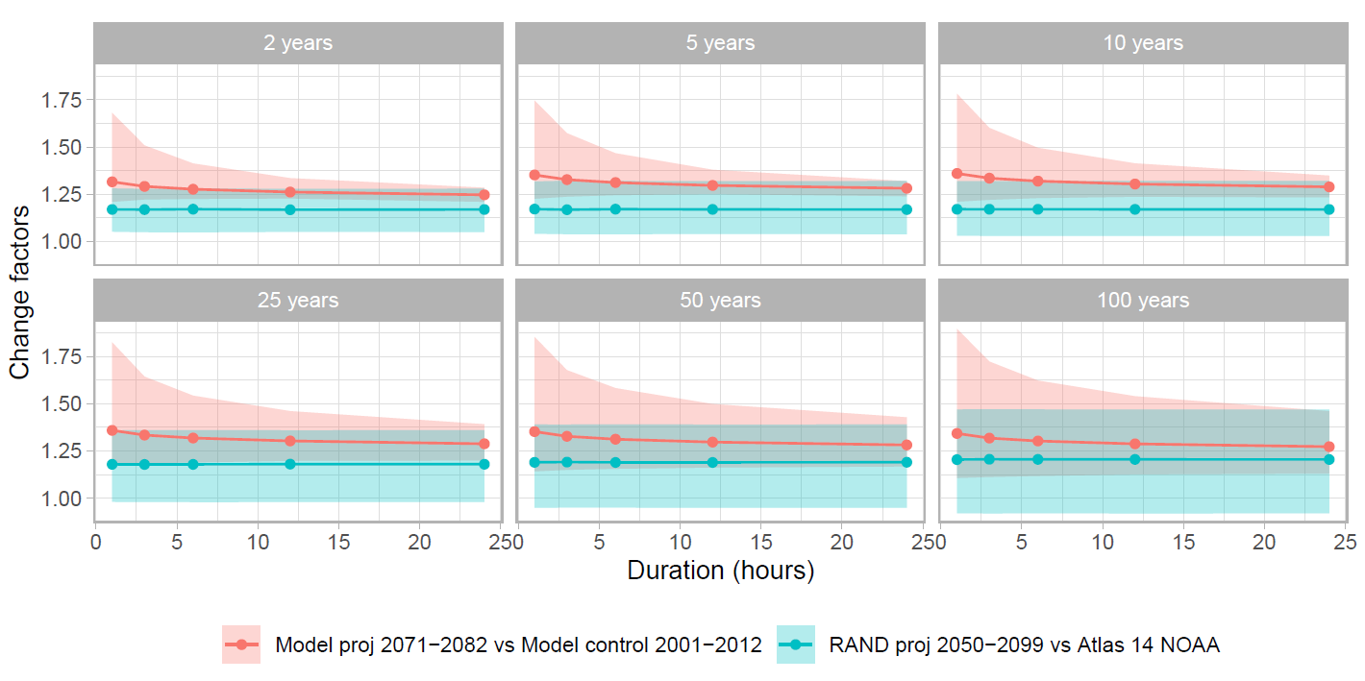
Discussion: Comparison with RAND Study
RAND (lower-resolution, no convective precipitation): Median change factor of 1.18
Our study (CPM, accounts for convection): Median change factor of 1.30
Our study's 80% confidence intervals consistently remain above 1, suggesting a consistent increase in rainfall

Slide 32
Conclusion & Future Directions
Key Findings Confirmed: Recent extreme rainfall in Southern Maryland significantly exceeds 20th-century levels, and high-resolution models project even greater future intensities
Underscores nonstationary nature of extreme precipitation
Highlights inadequacy of historical Atlas 14 data for stormwater management design
Implications for Risk Management
Quantitative estimates of current and future risk dynamics are crucial for actuaries and the public
Current property insurance contracts should integrate up-to-date estimates to maintain viability
Estimated trends should compel insurers to adjust future products and advocate for climate mitigation
Broader Applicability
This project offers a science-based template for other jurisdictions nationally
Fosters dialogue on adopting new methods for developing regulatory standards and risk reduction strategies that explicitly account for projected climate change

Slide 33
Thank you!
Questions?

